Slide 1

Intro to
Programming
With python
Recursion:
part 1I
Wednesday, April 23 2025 TOH210
Notes:
Layout objects pulled from: https://slidesgo.com/
All icons are from: https://thenounproject.com/

Slide 2

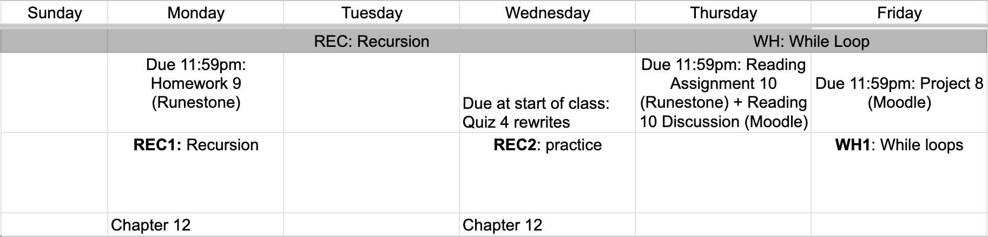
this week
google sheet link
Next Monday is Quiz 5
Notes:
https://docs.google.com/forms/d/e/1FAIpQLSe3OloPAJSid4n6cyU_4qXpRWU7FOSmP7IVdRS_vh9cvYd9zQ/viewform?usp=sharing

Slide 3
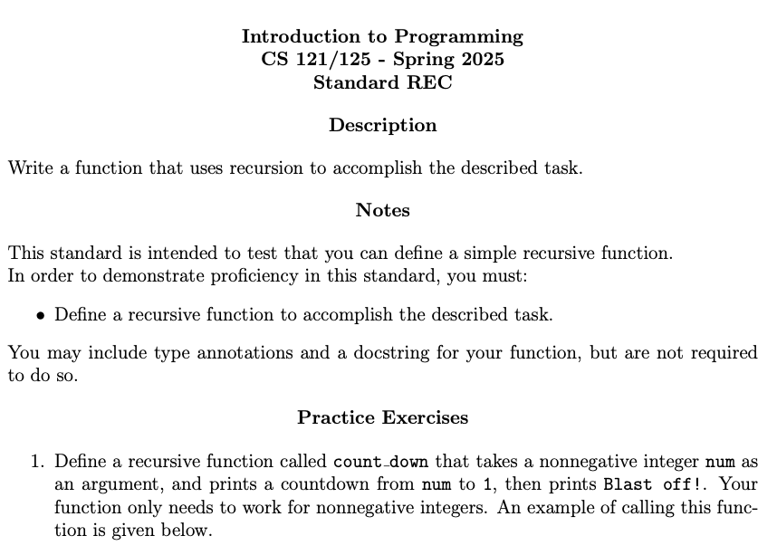
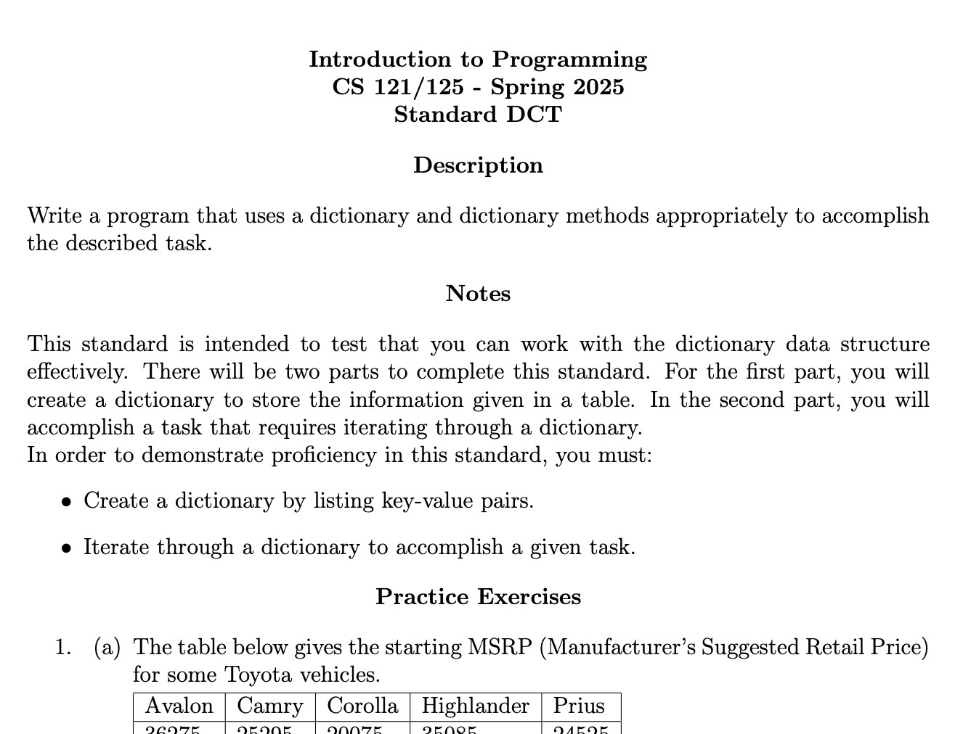
standards up on Moodle

Slide 4
Takeaways from last time
Procedural programming: organizing your program with functions
Recursion: a function that calls itself
base case (don’t forget this! do it first)
recursive step

Slide 5


WARMUP
create Python file
Recursive sequences
Consider the sequence of numbers defined by:
X0 = 1 and Xn=2Xn-1+1
Think about how these rules can be translated into a recursive function. Then define a recursive function x_sequence that takes an integer n as an argument, and returns the value Xn.

Slide 6
In recursion, functions call themselves!
But you need to organize it a bit to make it work
Base case: start with smallest way it could work
Recursive step: work your way slowly back to base case
def factorial(n):
if n == 1:
return 1
return n*factorial(n-1)
factorial(3) ->
3*factorial(2) ->
3*2*factorial(1) ->
3*2*1
= 6

Slide 7
Sometimes recursion is not always the answer
recursion ++
can be easier to write the function
Everytime a function is called, new memory is allocated to keep track of what's happening in that function
recursion --
often uses more memory
can be slower
If it uses basic data types, it’s usually alright but the more complicated the data type the more it’ll eat up space in memory

Slide 8

exercises
recursion practice worksheet
Grab a partner and a space at a whiteboard. One partner is the coder, one is the planner. Make sure to plan out your program in psuedocode (no actual Python code) prior to implementing it.
The questions we have are around sequences (#1-3), an annoying song (#4), and drawing with turtles (#5-7).

Slide 9

before next time
Finish worksheet
Read Project 8

Slide 10
def x_sequence(n:int)->int:
``` Finds xn value from the sequence defined by
x0 = 1 and xn = 2*x(n-1)+1
args: n(int), integer value
returns: xn (int), sequence value at n
```
if n == 0:
return 1
return 2*x_sequence(n-1)+1

